Slide 1
AUGMENTED (AR) AND VIRTUAL (VR) REALITY
MENLIBAY ZHANBOTA

Slide 2
VIRTUAL REALITY (VR)

Slide 3
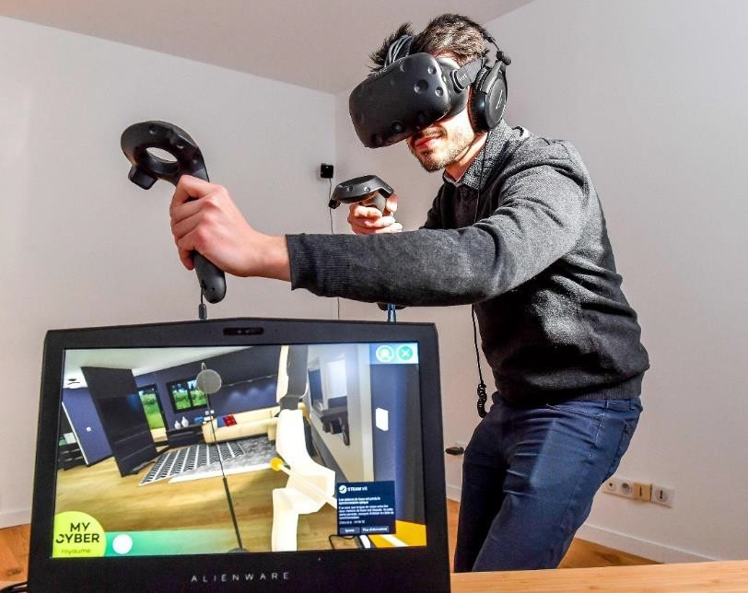
Virtual reality (VR) is a simulation experience that can be similar to or very different from the real world.

Slide 4
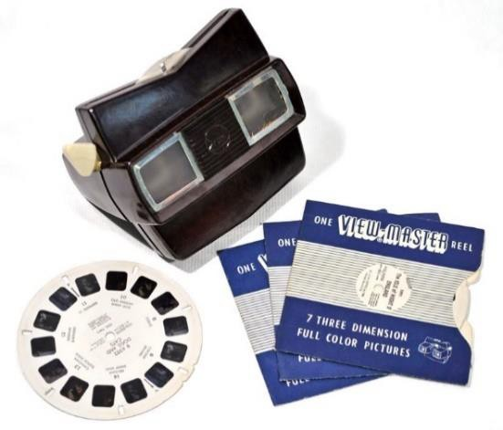
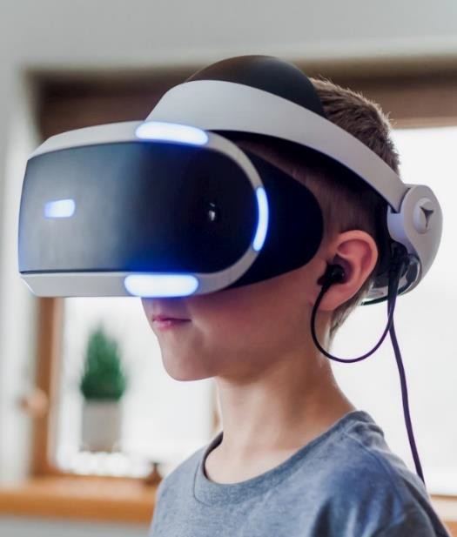
View-Master, 1939.(one of the first VR glasses)
VR glasses of the moment

Slide 5
Today, 3 main categories of virtual reality modeling are used:
▶ not immersive
▶ semi-immersive
▶ full immersive simulation.

Slide 6
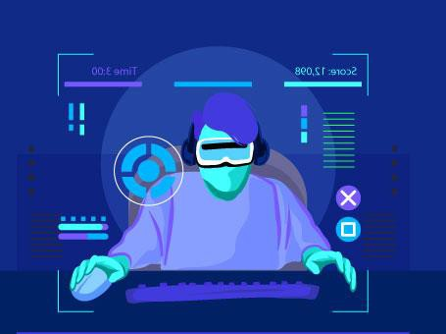
NOT IMMERSIVE
▶ Then you can control some characters or actions in the software, but the environment does not interact directly with you

Slide 7
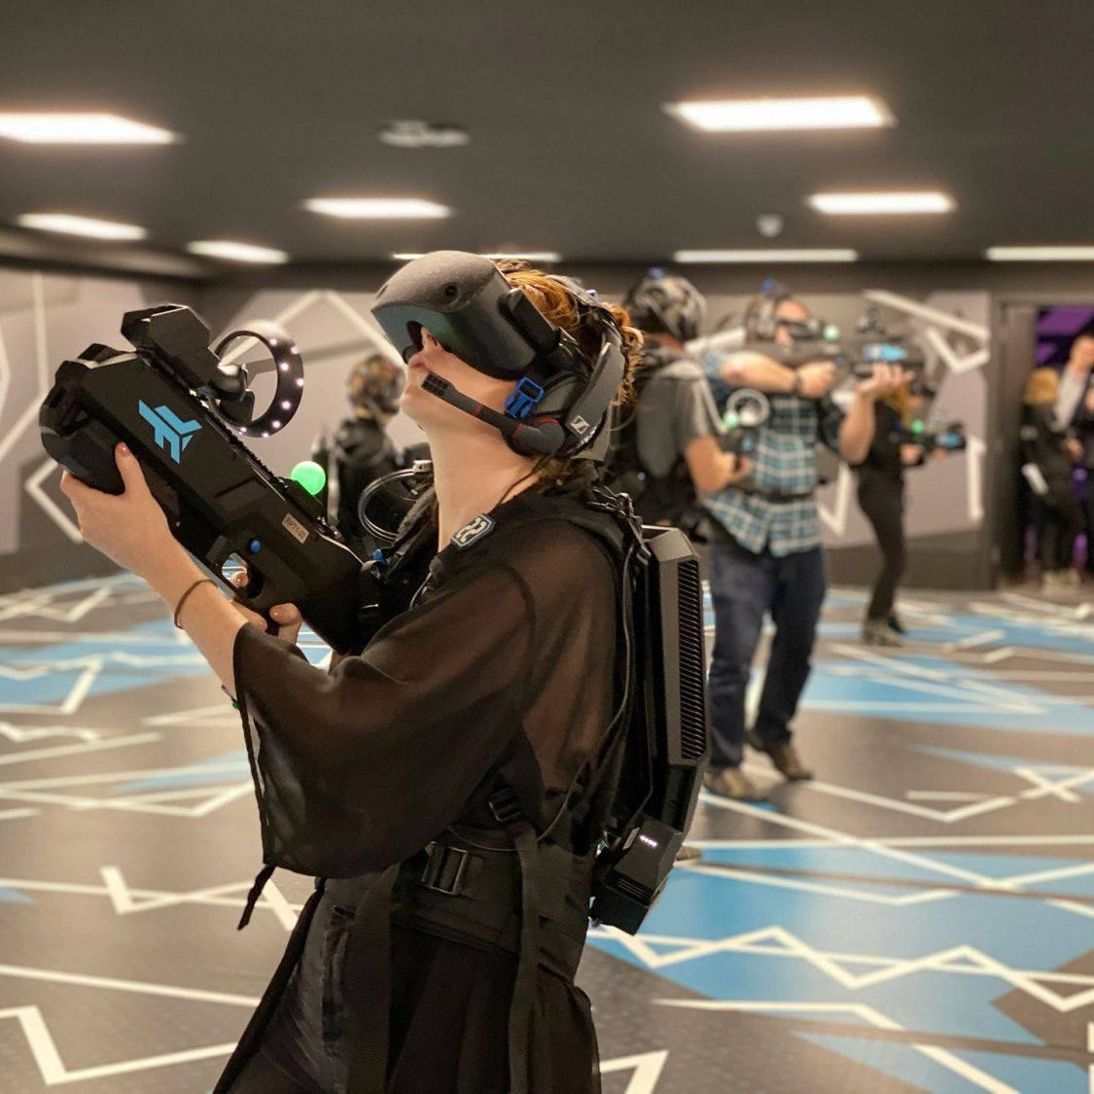
FULL IMMERSIVE
▶ It gives you the feeling of being in this virtual world and everything really happens to you.
▶ This is an expensive type of virtual reality, which includes a helmet, gloves and body switches with touch sensors.
▶ They are connected to a powerful computer.
▶ Your movements, reactions and even blink of an eye are detected and projected in the virtual world.
▶ You feel yourself in the virtual world.

Slide 8
SEMI-IMMERSIVE
▶ A mix of non-immersive and completely immersive virtual reality.
▶ Then you can use the computer screen or You can walk through the VR headset on your own.
▶ Thus, all activities in the virtual world are focused on you.
▶ However, you have no real physical movements other than your visual experience.

Slide 9
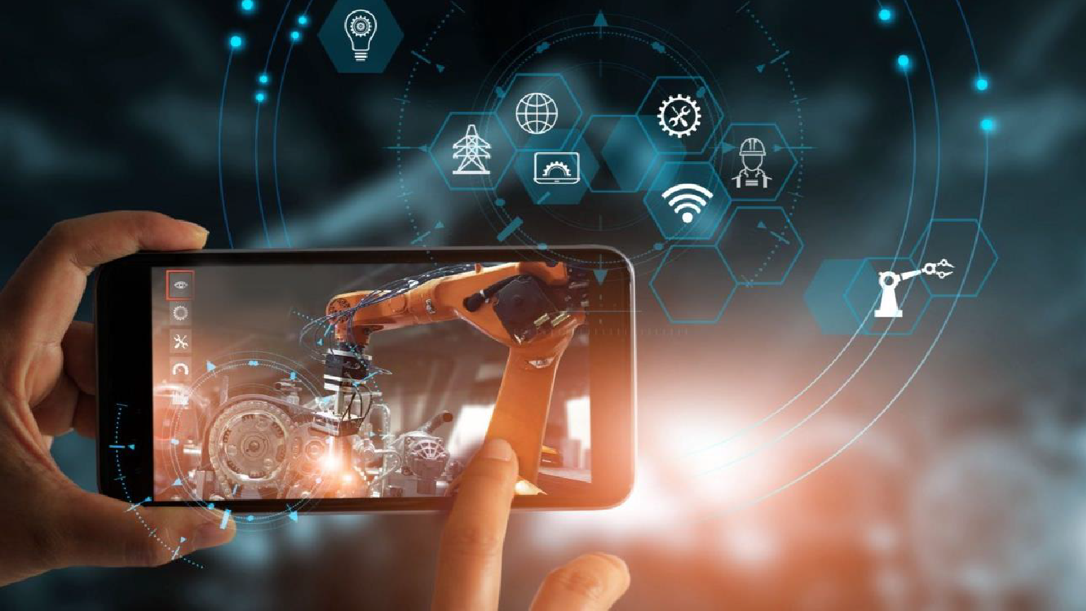
AUGMENTED REALITY (AR)

Slide 10
The scope of AR

Slide 11
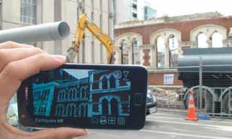
Architecture
CityViewAR program

Slide 12
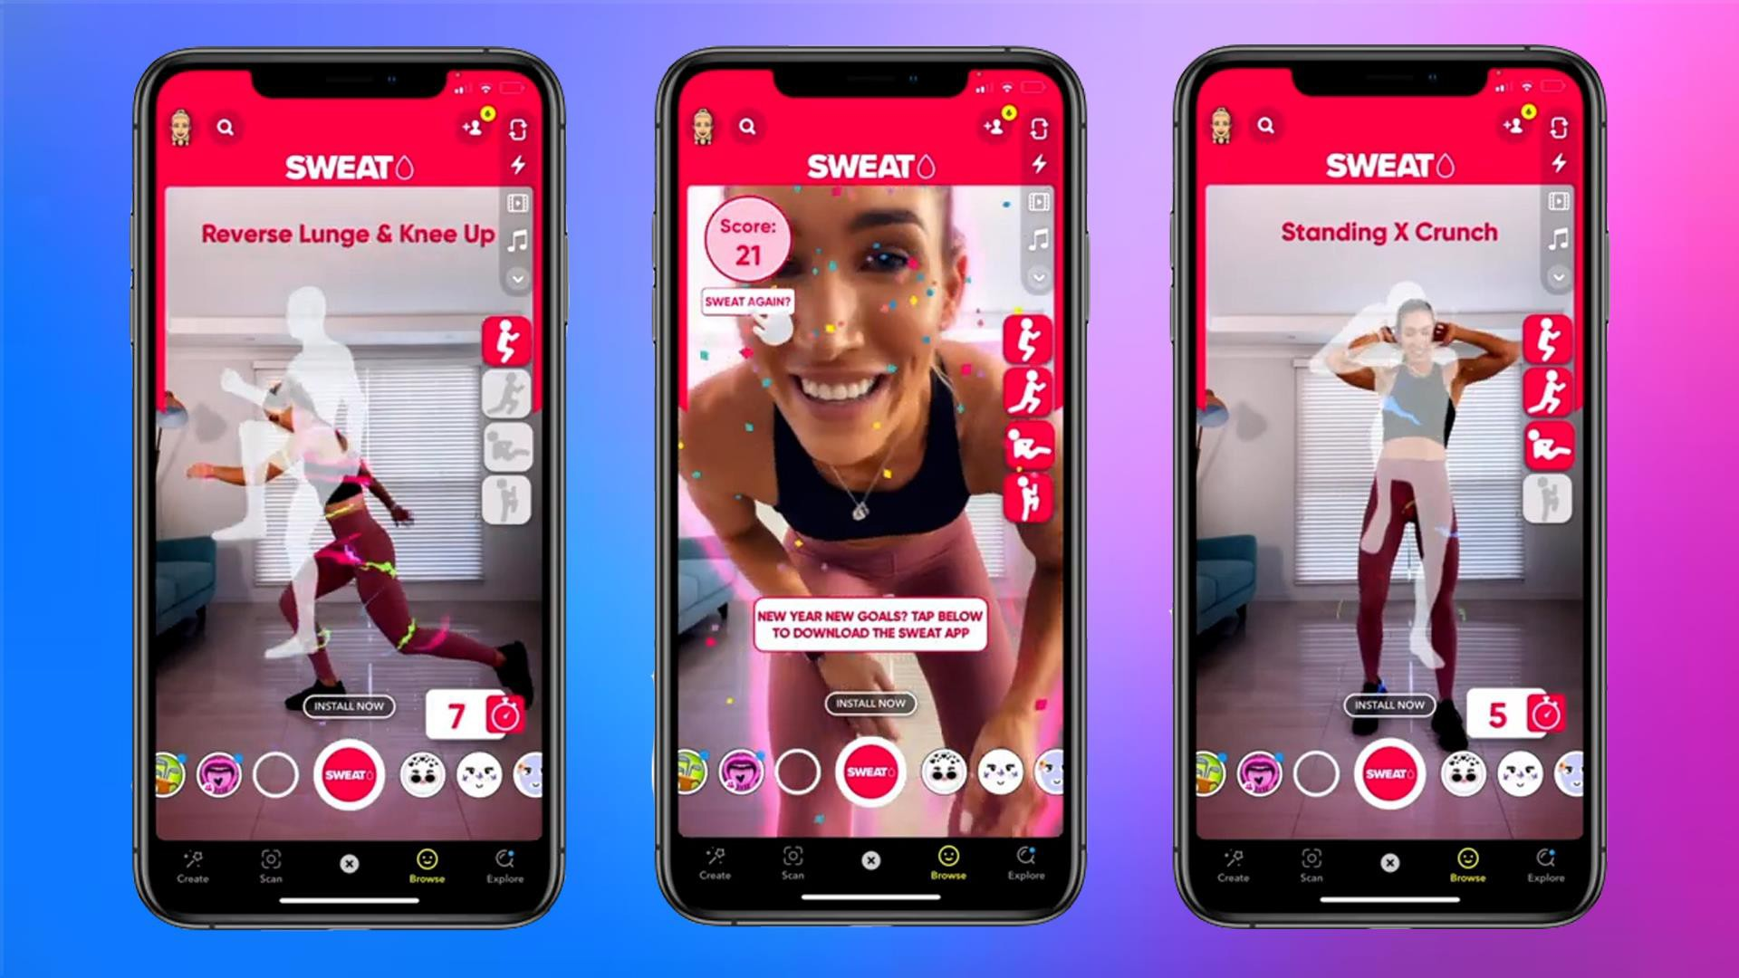
Fitness

Slide 13
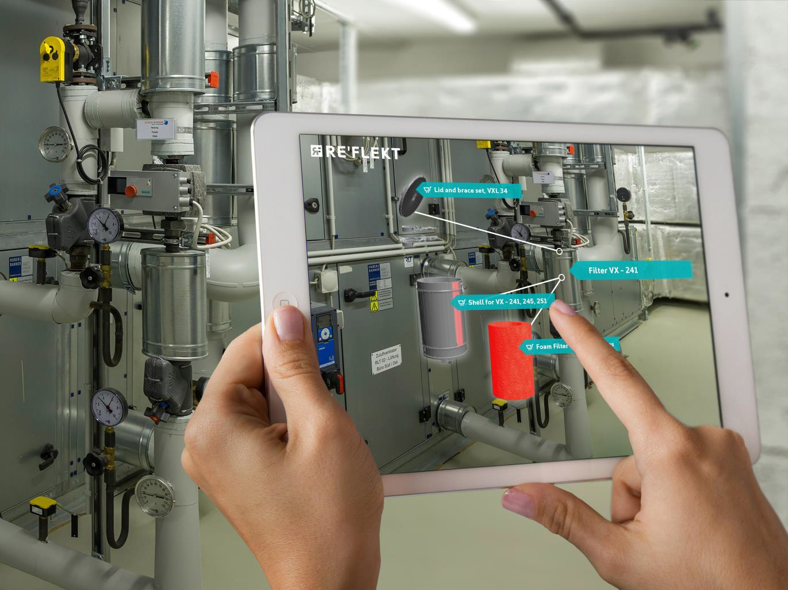
Production area

Slide 14
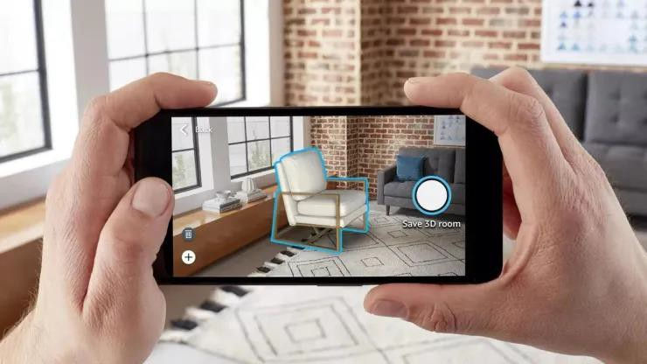
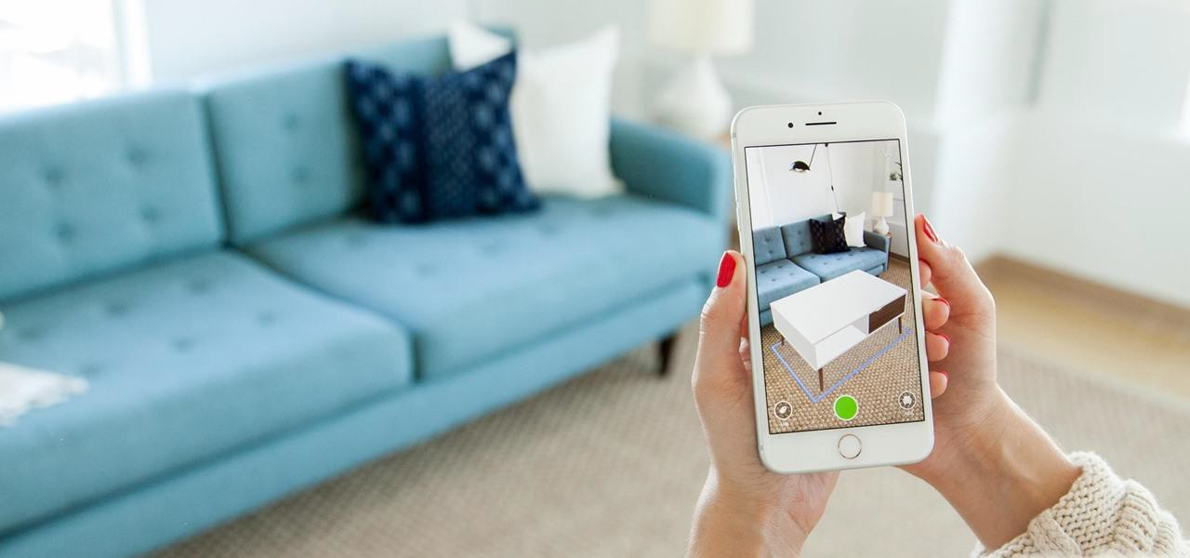
Marketing and sales

Slide 15
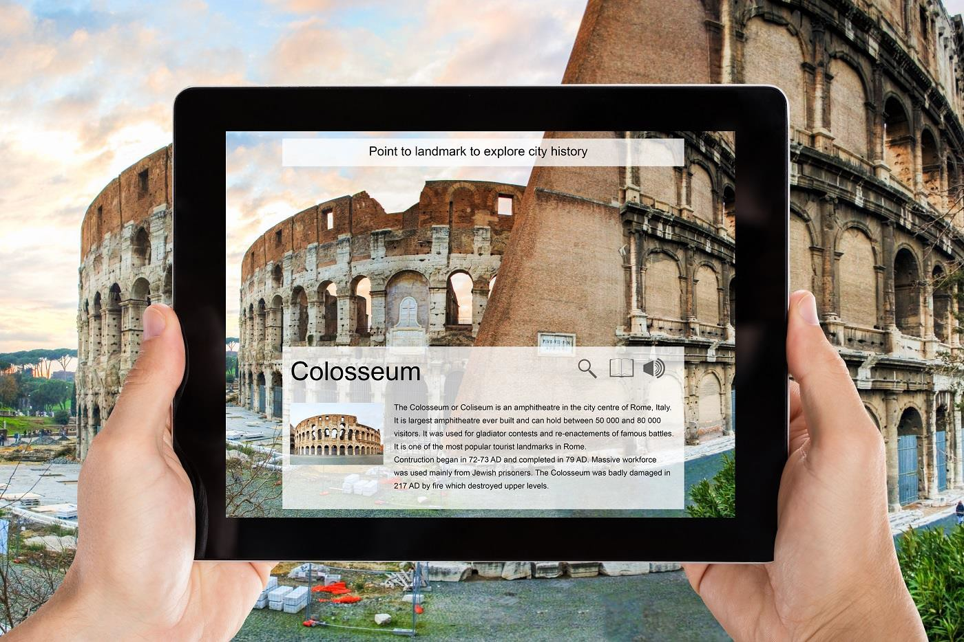
Tourism and attractions

Slide 16
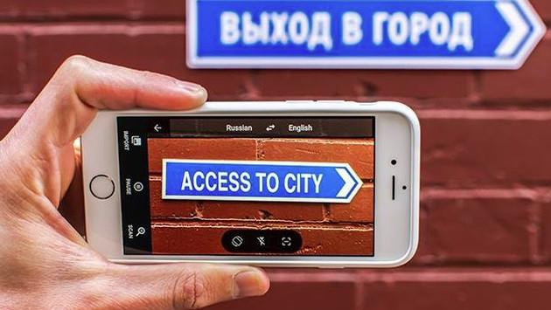
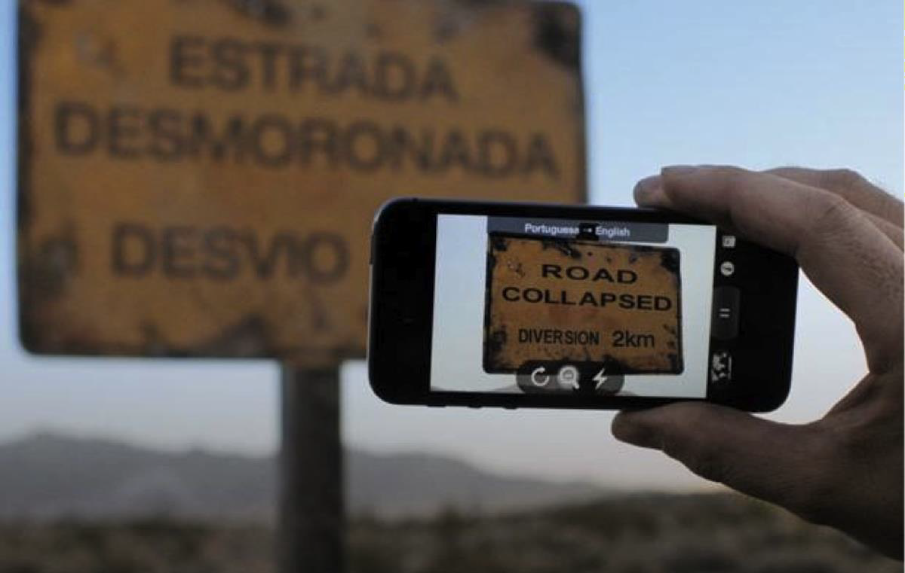
Translator

Slide 17
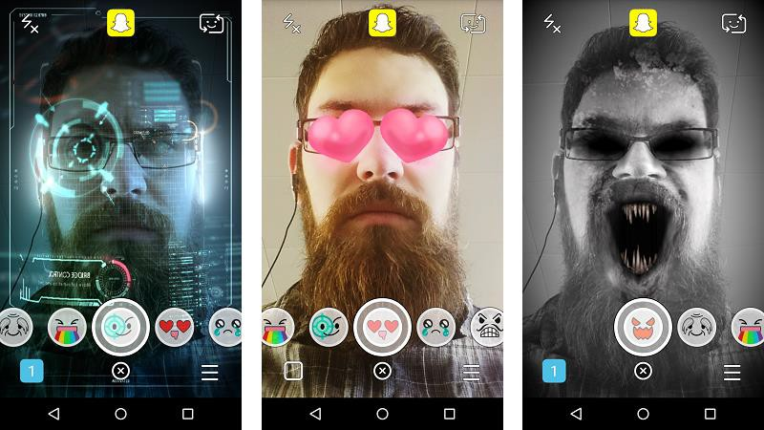
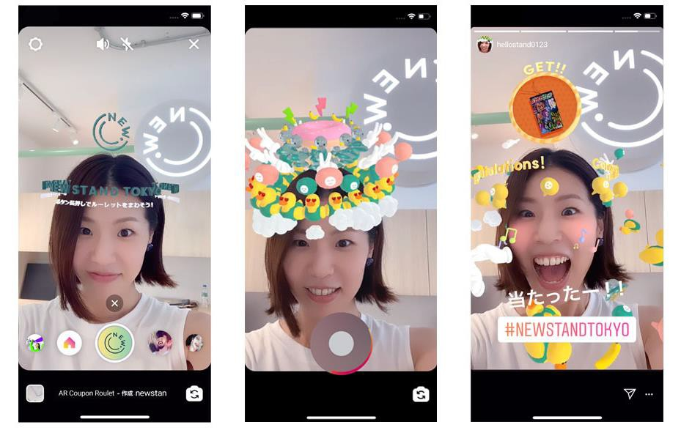
Social networks
Snapchat
Instagram

Slide 18
VR vs AR

Slide 19
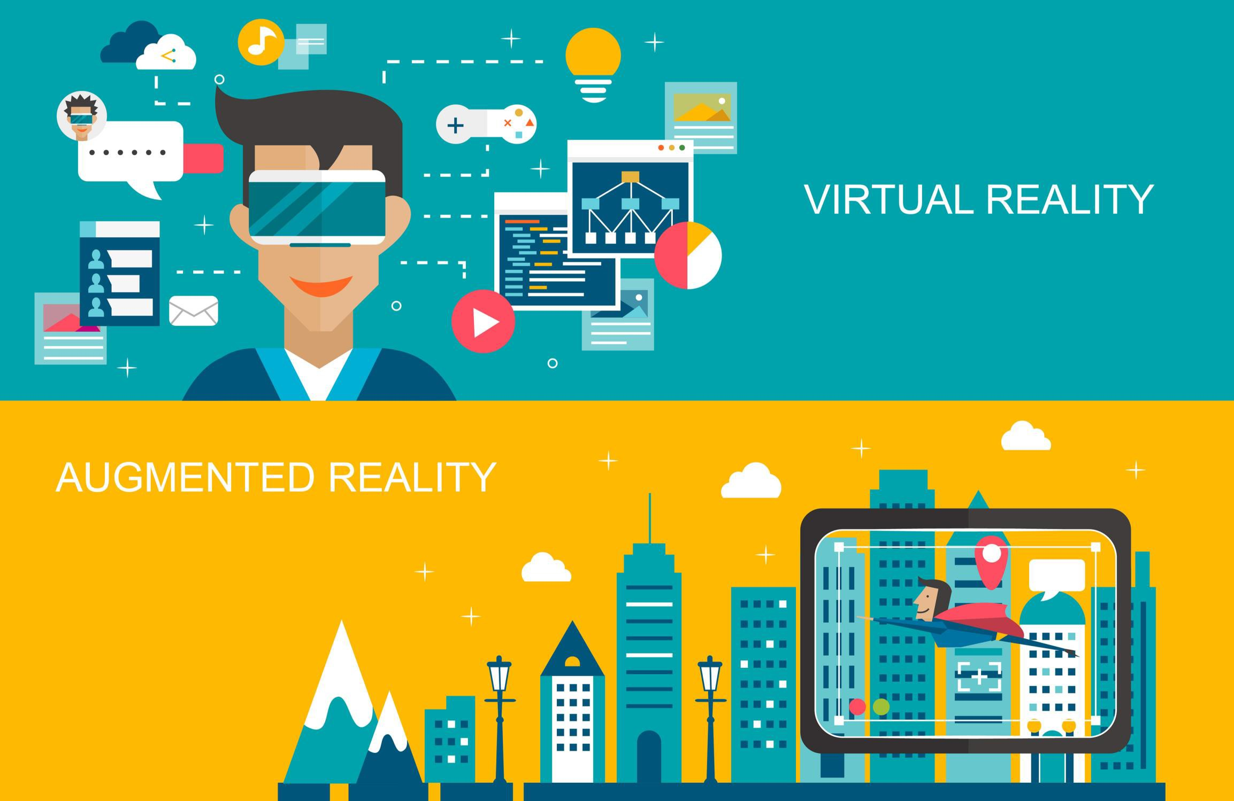

Slide 20
How to create an AR program?

Slide 22
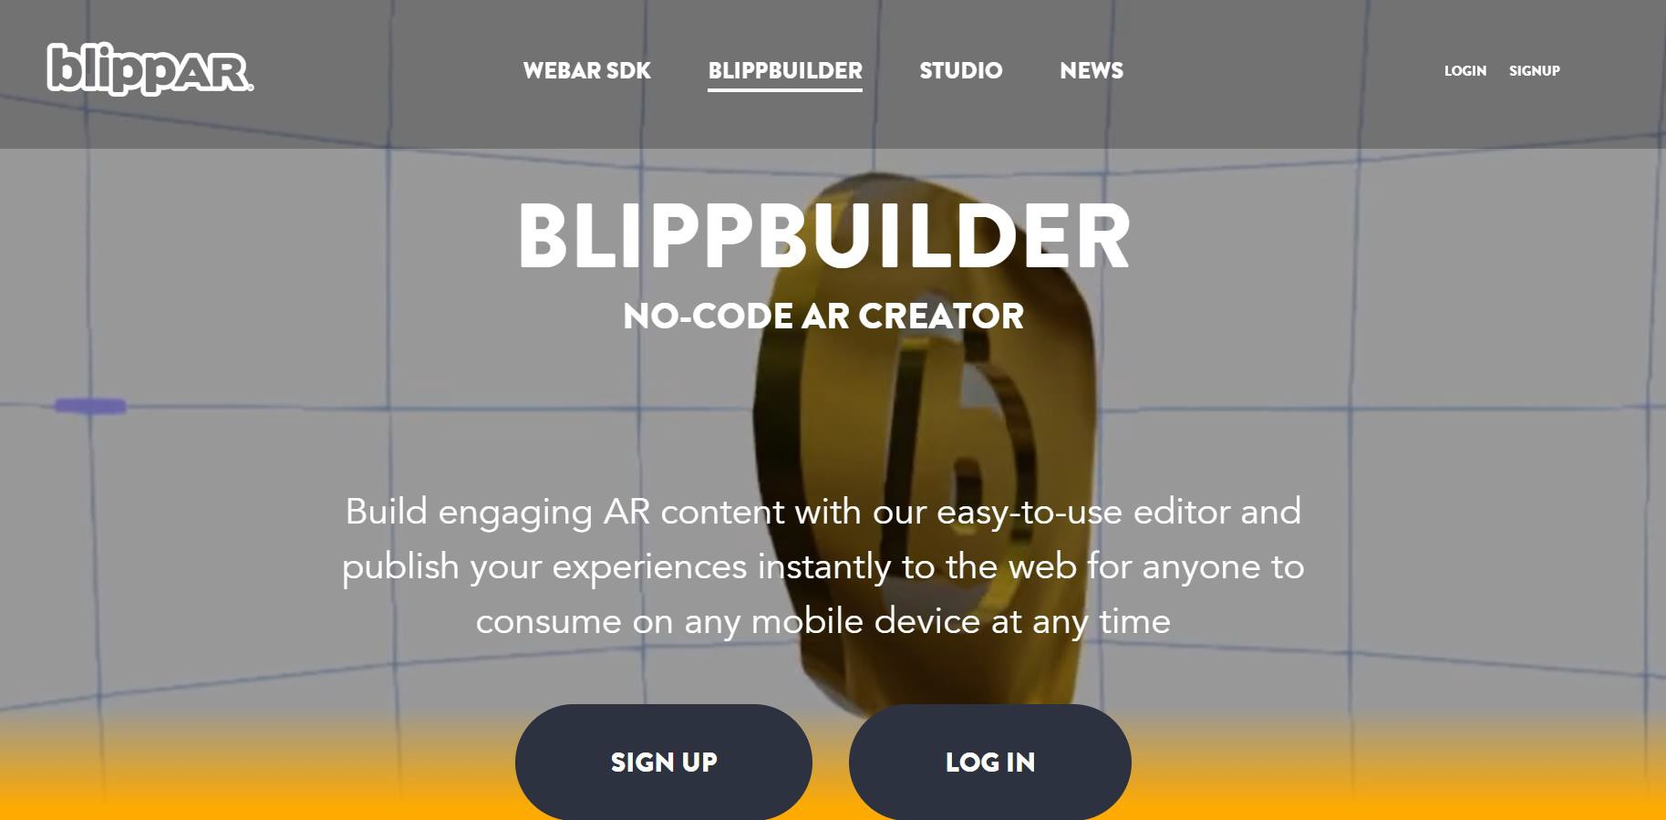

Slide 23
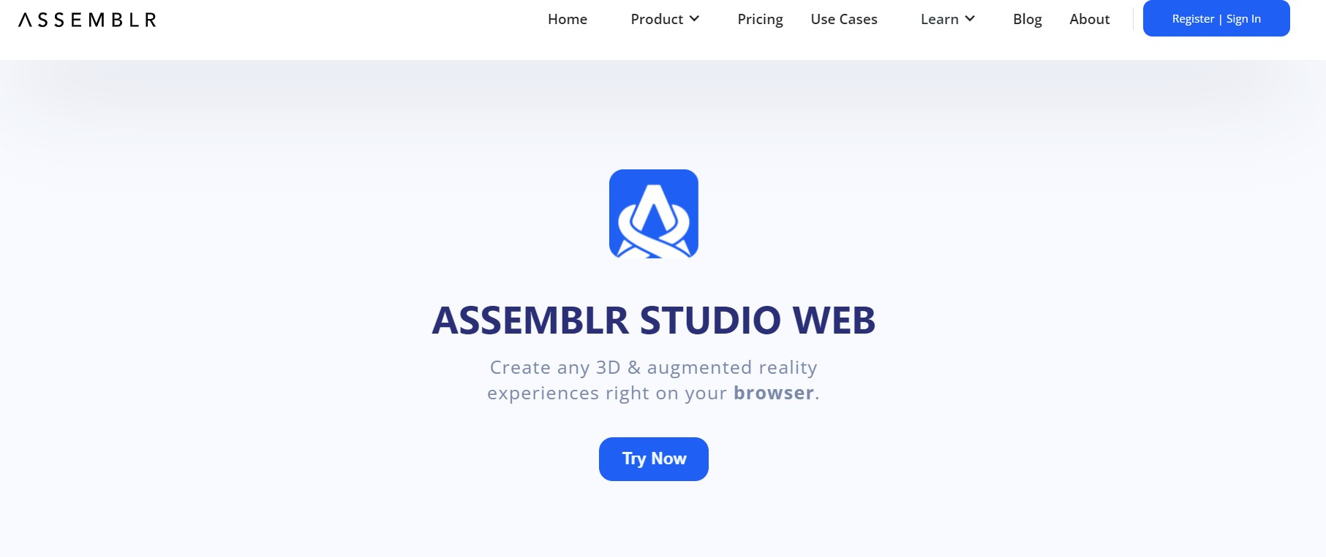

Slide 24
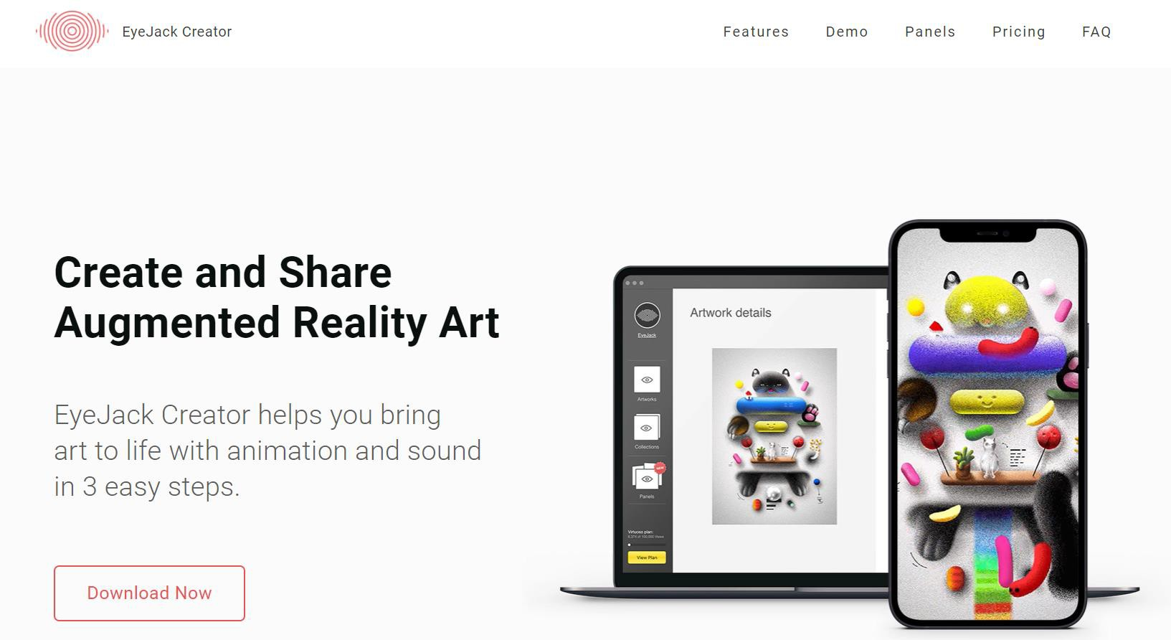

Slide 25
